Slide 1




PEEROLOGY: Peer Work through the lens of alcohol and other Drugs

Slide 2

Introductions
Steve is a Peer Support Worker with EACH since 2012
Vanessa is a Peer Support Worker with Access Health & Community and
Medication Support and Recovery Service since 2017
Craig is Peer Support Worker with Turning Point since 2018
Notes:
Intros and where we are from.
Icebreaker game with Vanessa

Slide 3

Outline
The Victorian AOD Peer Workforce Community of Practice – Who we are and what we do
What is the AOD Peer Workforce?
Peer Work roles in Victoria
Collaboration, shared expertise and multidisciplinary teams
Overlapping experiences – AOD and MH
Unification of Peer Workforces across domains
Personal and client perspectives
Notes:
Outline- Craig

Slide 4
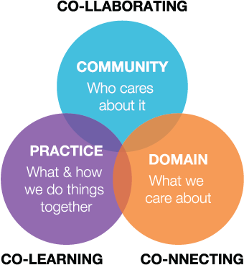
The Victorian AOD Peer Workforce Community of Practice
What is the Community of Practice?
Notes:
Steve- Like any discipline, it is imperative that the peer workforce has an ongoing mechanism for networking, development and information exchange.
The AOD Peer Workforce Community of Practice (CoP) supports and cultivates the existing and emerging peer workforce and seeks to draw upon the collective knowledge, experiences and resources of our community to provide:
Continuous professional development
Collegiate support to underpin sharing, resourcing and collaborative problem-solving
Vanessa- Opportunities for consultation and feedback to enhance the development of the peer workforce
SHARC’s AOD Peer Workforce Community of Practice meets quarterly, is open to all paid peer workers in Victoria and serves as an opportunity to network, celebrate the discipline and feedback trends to agency, community and government.

Slide 5











The Victorian AOD Peer Workforce Community of Practice
Who are we?
Notes:
Steve- These are the organise represented

Slide 6



The Victorian AOD Peer Workforce Community of Practice
What we have achieved so far
Notes:
Craig-
We collaborated to develop the ‘A Strategy for the AOD Peer Workforce In Victoria’
Which includes:
Vision for the AOD Peer Workforce
Making the vision a reality: Key domains & Actions
Collaboration with mental health workforce development, three workforce strategys are to be released and actioned this includes the menatlk health carer and consumer workforce strategy
We collaborated to develop an appendix that covers Peer Workforce implementation in the newly revised Victoria's alcohol and other drug program Guidelines.
The peer workforce have been recognised in the recent Victoria Alcohol and other Drug Workforce Development Strategy 2018 – 2022.
We collaborated to develop an appendix that covers Peer Workforce implementation in the newly revised Victoria's alcohol and other drug program Guidelines.
Through our work in defining the workforce and developing a vision and values for the future we have been recognised in the recent Victoria Alcohol and other Drug Workforce Development Strategy 2018 – 2022.
This strategy highlights the importance of, and departmental investment in, the AOD peer workforce:
‘The value of peer workers in the AOD sector is immense and often quoted as a necessary part of recovery. People seeking help are less likely to feel judged or stigmatised by those who have a similar experience.’ p 28.
‘Peer workers across the Victorian AOD treatment sector will bridge the gap between intake and admission to treatment and expand options for continuing care and recovery coordination after treatment planning.’ p28.
‘The AOD sector needs to further develop and embed the peer workforce within organisations and services and ensure appropriate training and support for peer support workers in these new roles.’ p26.

Slide 7

The Victorian AOD Peer Workforce Community of Practice
Vision for Peer Workforce
Peer work will be understood, valued and recognized as its own professional
discipline.
The peer workforce will be established as an integrated part of service design and
become an embedded model for the sector
Peer Workers and the sector will be supported by a central resource for peer
workforce development.
The peer workforce will be provided specialized training, supervision, professional
development and networking opportunities
Organisations will be educated and adequately prepared for the introduction and
sustainability of the peer workforce
Adequate resources will be granted for the growth and sustainability of the
peer workforce.
Notes:
Vanessa-
Vision for the AOD Peer Workforce - this underpins the strategy soon to be launched
Realising this vision
Unification between peer workforces in all health domains – harm reduction, dual diagnosis, mental health
Ensuring the growth and sustainability of the workforce
- and crucial factors to support this e.g org readiness, resourcing, peer worker specific training and supports
Ongoing development of the workforce e.g. while ensuring consistency and purity of peer work in the state we are increasingly building the discipline and ensuring its value to the communities we serve
- Adequate resources and training- “I benefit from being included in all of the training offered to the counselling team both in my personal world and in the support I can offer to others in that it helps me to understand them and what’s impacting on them. So much of what we do is in the relationships”.

Slide 8

What is a Peer Worker?
A Peer Worker utilises their lived experience of alcohol and other drugs, plus skills learned in formal training, to deliver services in support of others.
Notes:
Steve- When trying to define what a peer worker was.
What was this fabled mythological creature? - a lot of time was spent on a definition that was broad and defined enough for the COP to be able to officially use.
Recovery vs healing. Peerology

Slide 9
What is the AOD Peer Workforce?
We counsel but are not counselors
We support peoples change process but are not clinicians
We deliver trauma informed care but are not trauma therapists
We liaise with government and other stakeholders but are not politicians
We advocate for consumers rights but are not activists
We assist in clinical care but are not psychologists
We are a trained, lived experience workforce. A discipline in its own right
Notes:
Craig- Peerologists- what are we and how do we operate ?
diversity of the role.

Slide 10
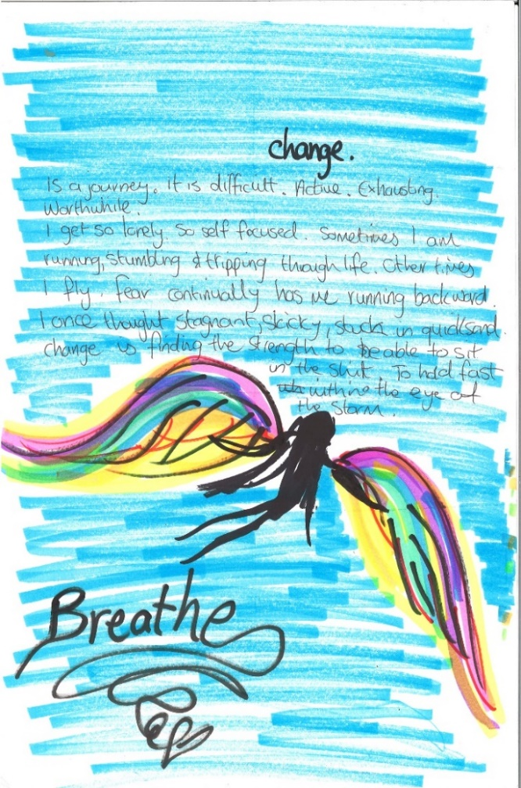
AOD Peer Worker roles in Victoria
AOD isn’t just about alcohol and drugs….
Housing
Comorbidity
Legal Matters
Income and Finances
Family support
Outreach
Creative Arts
Advocacy
Medication
Liaising with stakeholders and the community
So Peer Work in AOD is more than just talking and
sharing the lived experience….
Notes:
Craig-
Talk about the different roles that peer workers undertake. Broad and varied.
Working in hospitals & clinical settings. Working in the community and the courts. Peer workers work with families, psychologists, doctors, housing workers, artists, local & state governments. And of course the clients themselves.
That the COP is a way of providing consistency and definitions within the roles

Slide 11

Clinical and client perspectives
“The Peer Worker put us back on track and remind us what we need to do. They have lots of insight and information, and they know what we are going through. They are motivating because they have succeeded. They have walked in our shoes.”
Family Drug Treatment Court participant
“I like referring clients to a Peer Worker when a client appears to be skeptical of nurse input. Peer Workers offer no bullshit reality, credibility and hope to clients where nurses might not be able to.”
Neil, Nurse, Eastern Health Withdrawal Unit
Notes:
Vanessa- we do a lot of tea and biscuits….
In clinical and community settings- statstics and examples.

Slide 12
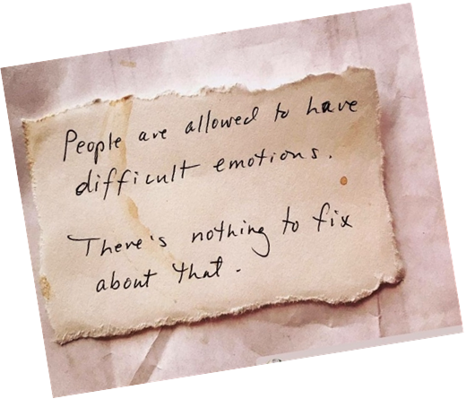
Collaboration, shared expertise and multidisciplinary teams
While it is important to have an understanding and knowledge of and cooperation across service areas, we also need to acknowledge the unique skills set of the AOD Peer Work force as a standalone discipline.
“Counsellors feel more supported by having a peer role in the service delivery model, someone to also consult regarding a lived experience perspective. For example, Clinicians have consulted with Steve about how to best support their clients from his perspective…I truly value his ideas and expertise.”
Rebecca Patane, EACH
Notes:
Steve: Collaboration and shared care approach
I was really fortunate to be employed by a program created..( in consultation with Ken Minkoff and Crhristy Cline incidently) with the idea in mind that it’s less effective to treat substance use issues in isolation without considering the impact of that person’s life circumstances. In a bio-psycho-social model. And the outlook for the people coming to our service would improve if there was better collaboration and communication across disciplines. As a federally funded progam, our project helped build cross-sector capability with a series of collaborative training session and networking meetings between services.It helped that we sat in a Community Health setting with multi-discplinary services available.
And there has been several examples of ongoing efforts to achieve this like the in tandem model being spoken about next door and indeed the organisers of this forum.
The state-wide sector reforms in the AOD and Mental Health fields and Introduction of the NDIS and various organisational restructurings as a result, have all done their part to stifle collaboration and open sharing of opportunities to some degree.

Slide 13

Overlapping experiences –AOD, MH & DD
Peer Workers must be comorbidity capable
Notes:
Vanessa-
Trauma informed practice- recognizing trauma underpinning the drive to use drugs and alcohol.
Stigma. Cant treat one without the other. Shared care approach.
Balance of therapeutic work with a counsellor and support role with peer worker
Shared care/responsibility for clients well being
Consistent support when counsellor on extended leave.
Bring different learnings/perspectives to the client’s recovery goals
Advocacy and representation in case meetings and when mental health crisis presents. Vanessa
Craig
“I have recently joined the Dual Diagnosis Consumer and Carer Advisory Council (DDCCAC) which is made up of Peer Workers and management from Eastern Health’s mental health sector. This is a partnership we are hoping can be mutually beneficial in order to strengthen the relationship between AOD and MH. Currently members of the DDCCAC facilitate groups on Dual Diagnosis highlighting the crossover in AOD and MH at our 1East and Wellington House detox/stabilisation units. Ultimately we are aiming to work closer together and improve collaboration to provide best care for clients.
My hope is that clients coming through Upton House for assistance with their mental health who also have AOD needs can be assisted by AOD Peer Workers and vice versa with 1East and Wellington House. It is interesting to note that this collaboration came about by chance and I was unaware of the existence of the DDCCAC and mental health Peer Workers within Eastern Health until about 6 months into my role. It will be interesting to see what other initiatives we can bring together to improve client experience and I’m excited about the future.”

Slide 14
Unification of Peer Workforces across domains – why?
We all promote a reduction in stigma and contribute to social change
We need consistency of practice and care – simplify the journey
We want o be able to meet clients needs - regardless of complexity
We don’t want to reinvent the wheel
We see the similarities between fields – so we need to ask the question - how do we best work together?
Notes:
All of us.

Slide 15
Thankyou
Self Help Addiction Resource Centre SHARC
Department of Health and Human Services, Health and Human Services Workforce
All the Victorian AOD agencies that employ and support the AOD Peer Workforce

Slide 16
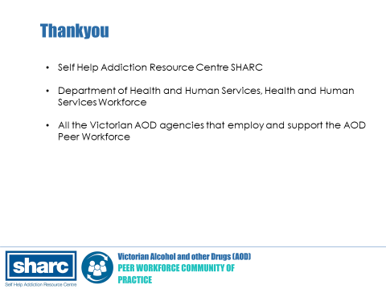

Slide 17
References
State of Victoria, Department of Health and Human Services, July 2018. Victoria’s alcohol and other drugs workforce strategy 2018–2022.
State of Victoria, Department of Health and Human Services, May 2013 Victorian Alcohol and Drug Treatment Principles.

